Slide 1
Make Final Fantasy Great AGain

Slide 2
What is Final Fantasy

Slide 3
JRPG vs. ARPG

Slide 4
Glory days

Slide 5
What happened?

Slide 6
What can be done?

Slide 7
Game Design
Narrative
- has consequences
Gameplay
Good character development for power fantasy
Thoughtful combat
Setting
Management

Slide 8
Narrative
Feels like it has consequences, impactful
Easy to understand, lore to find

Slide 9
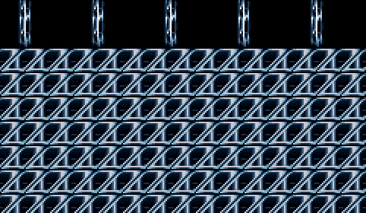
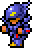
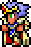

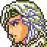

Slide 10
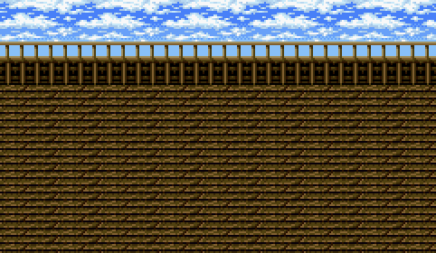
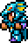

Cain

Slide 11
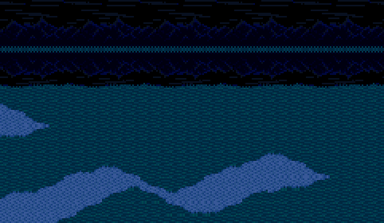

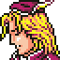
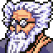

Tellah
Tellah attacks Golbez and casts spells on him, but finds they have no effect. He then converts his own life energy into the necessary magic power to cast Meteor, which severely wounds Golbez
Everyone surrounds Tellah, who is dying due to casting Meteor at the cost of his own life. He asks the others to avenge Anna for him, and dies.

Slide 12
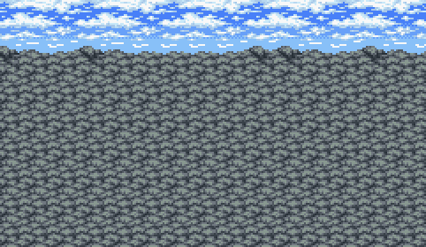




Palom and Porem
After defeating him, Cagnazzo has one last trick up his sleeve. When the party tries to escape, the walls cave in. Palom and Porom save Cecil's party by petrifying themselves. Tellah tries to heal them, but to no avail, as they have turned into stone of their own will. This act of sacrifice further strengthens the party's resolve to stop Golbez.

Slide 13
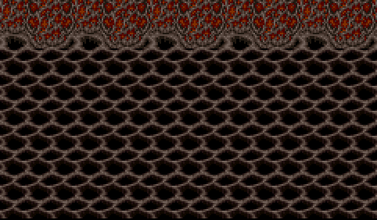




Rydia

Slide 14
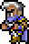

Edge
Edge is rude, hotheaded and stubborn, refusing to give up his pursuit of Rubicante and not backing down from the fight despite being outmatched. He is mean and obnoxious to the party at first, but comes to appreciate their help over time. He has an unrequited crush on Rydia and flirts with other women occasionally, remarking that Rydia and Rosa make "two babes in the party". He has a short temper and uses his rage as a source of power in his rematch with Rubicante, unlocking new Ninjutsu skills.

Slide 16
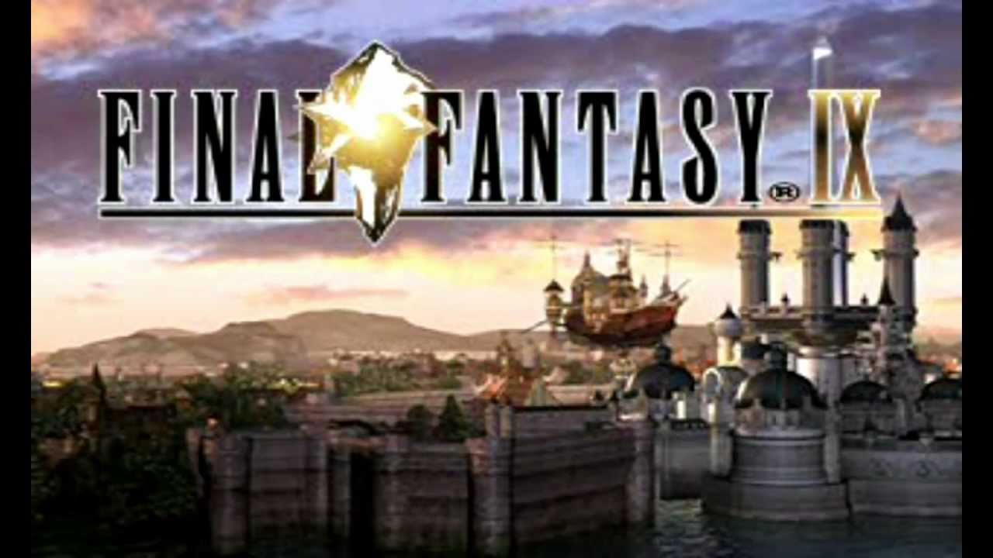
ff9
Every story on it’s own is sad, but when combined together make a beautiful story

Slide 17
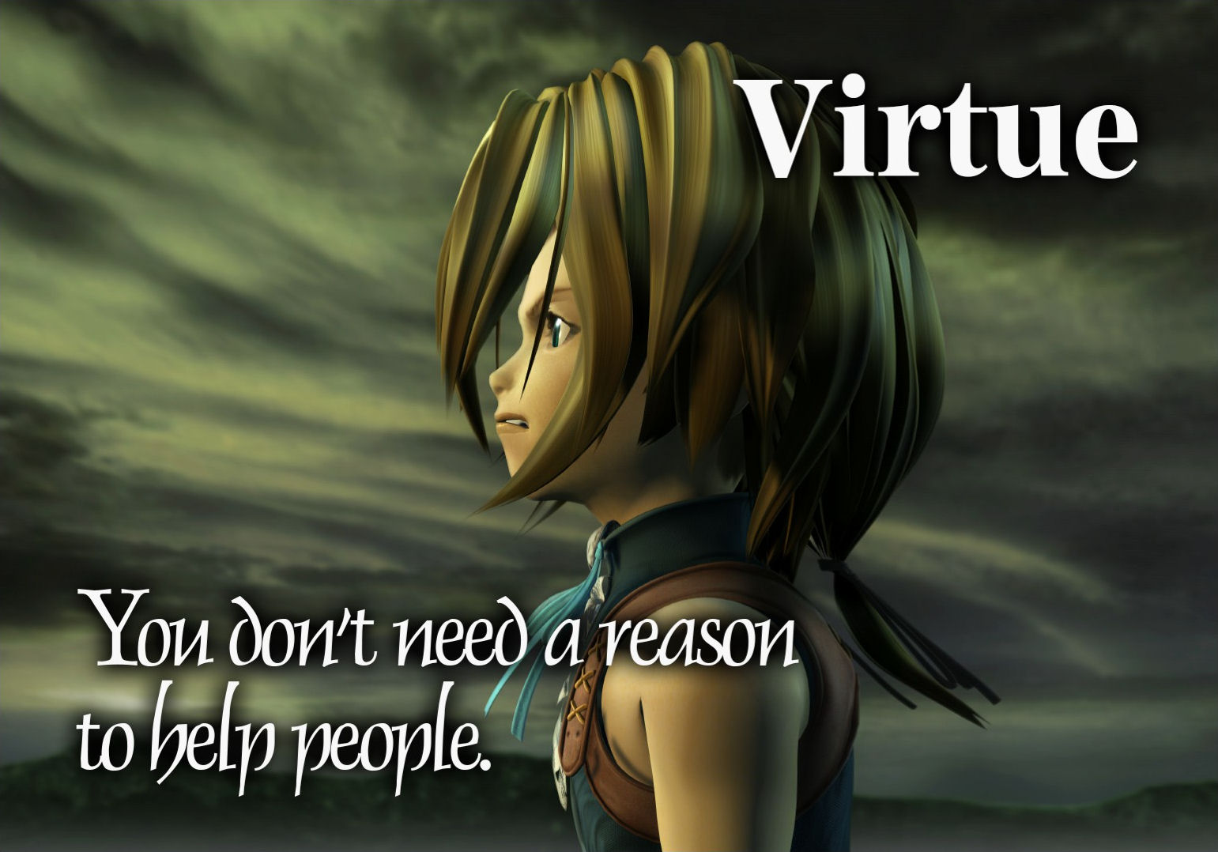

Slide 18
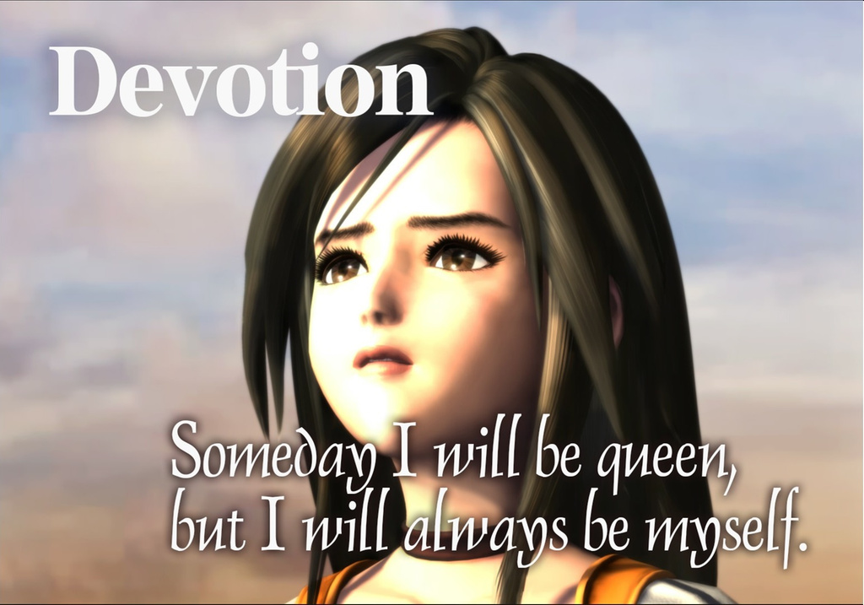

Slide 19
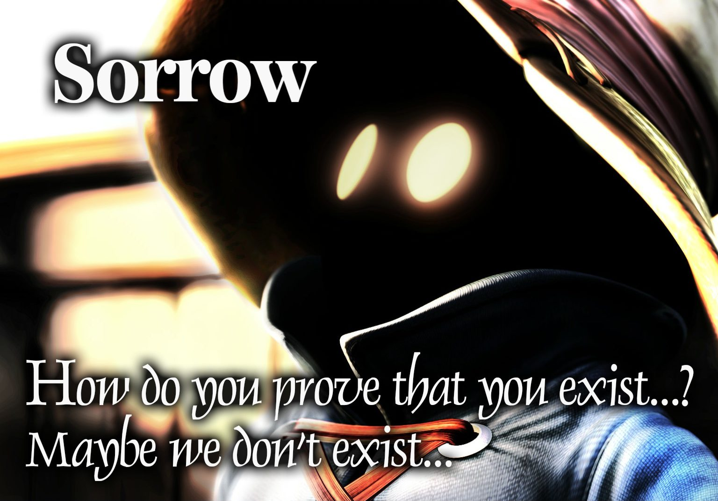

Slide 20
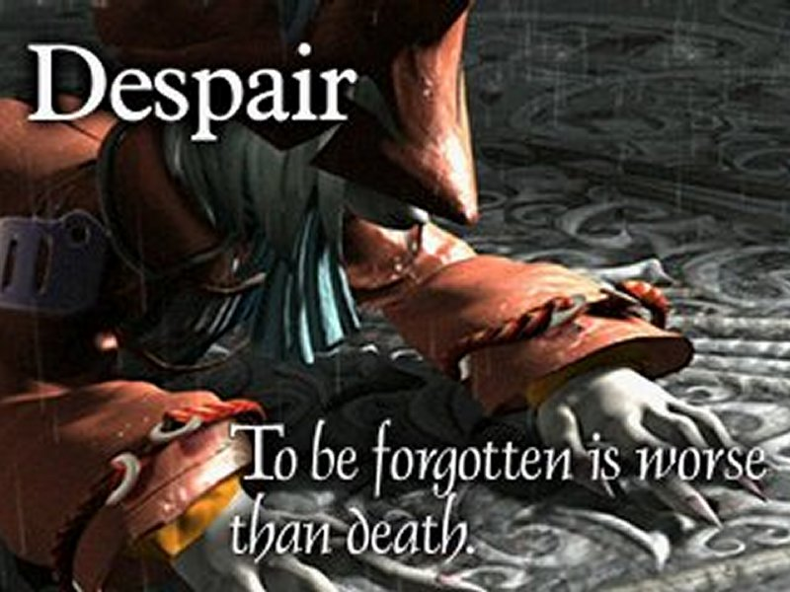

Slide 21
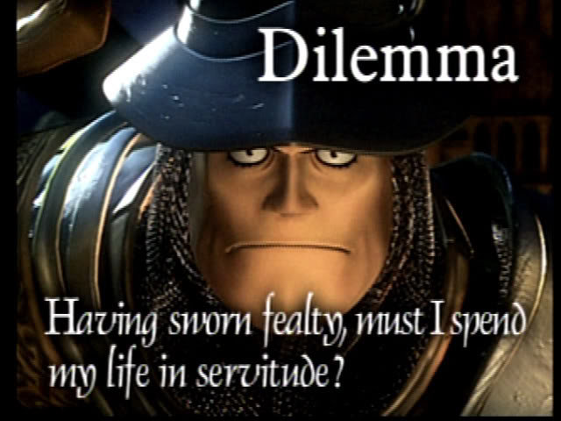

Slide 22
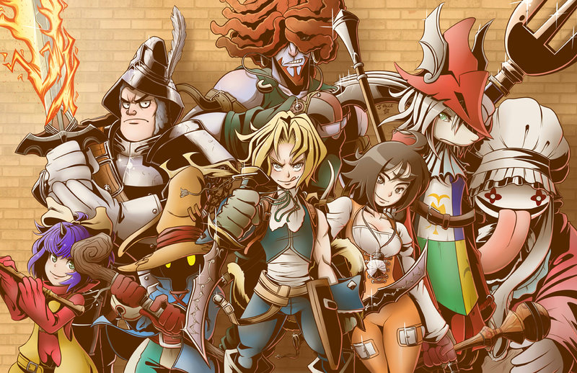

Slide 23
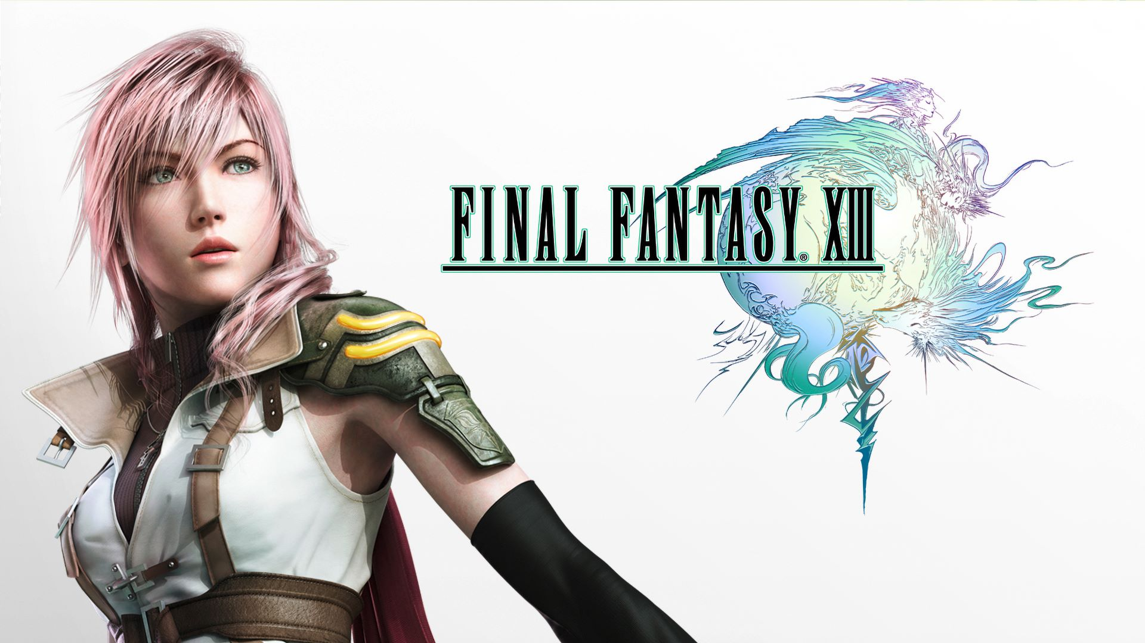
Lightning
You’d probably think that the girl on the cover of the box was supposed to be the main character, but ‘Lightning’ (a name which really just rolls off the tongue) has probably the least amount of personality or influence on the story of anyone.
Notes:
https://venturebeat.com/2011/05/13/why-final-fantasy-xiii-is-a-terrible-game/

Slide 24
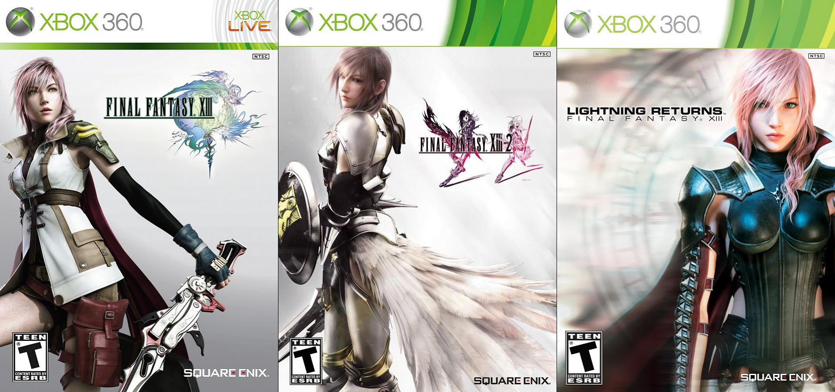

Slide 25
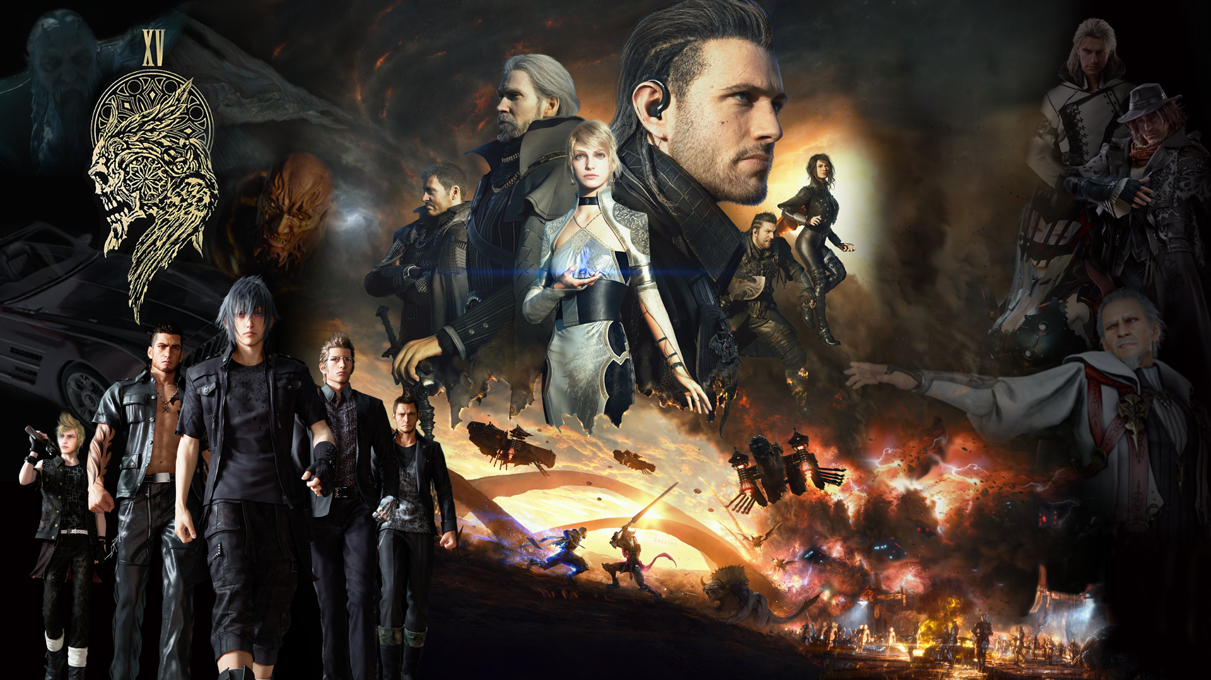
Notes:
https://www.deviantart.com/realzeles/art/Final-Fantasy-XV-universe-Wallpaper-1080p-620627951

Slide 26
Ffx good story
Intersting blelievable villains/monsters
Moral choices (marriage/duty)
World constantly feels like it’s about o end

